Slide 1
Effective Business Communication Competencies
7 Cs, Importance of NVC & Communicative Competencies

Slide 2
Unit IV- Technical Communication Skills
Exposition, Narration and Description Technique
Interview Skills – Objective, Types, How to prepare for an interview, Skills and attributes sought by interviewers and Dos &Don’ts
Group Discussion – Objective, Types, Methods and Dos &Don’ts
Argumentation Skills – Principles and Devices (Analysis, Cohesion, Emphasis, etc.)
Critical Thinking – Critical Thinking Skills and how to improve it.
Business Communication Competencies – 7 Cs, Verbal and Non-Verbal Communication, Discourse, Sociolinguistic, Strategic, etc.
Topics ‘A’ to be studied from First Year notes (Unit II).
Topics ‘B’ to ‘F’ to be studied from Second Year textbook and class notes.

Slide 3
Important Aspects of Business Communication
7 Cs
Importance of verbal & non-verbal components
Communicative Competence
Grammatical/Linguistic Competency
Discourse Competency
Socio-linguistic Competency
Strategic Competency

Slide 4
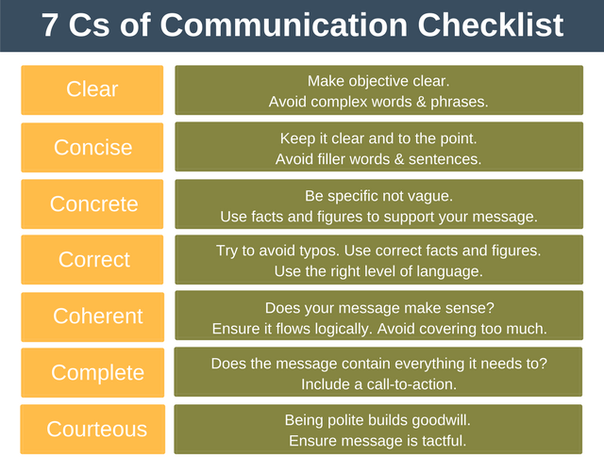

Slide 5
Importance of Verbal & Non-verbal Components
Verbal | Non- Verbal
Sharing ideas. Creating Relationships. Bringing Clarity. Increases Productivity through lateral communication. Provides job satisfaction through horizontal communication. Removes Barriers. Provides motivation. Persuasion. | Maintaining relationships through friendly facial expression. Use of aspects of paralanguage can make your communication interesting. Right body language works as a sign of confidence. Strengthens the first impression. Reinforce or modify what is said. Increases understanding of messages. Helps in knowing attitudes and feelings. Frame our verbalisation when it is difficult to use speech.

Slide 6
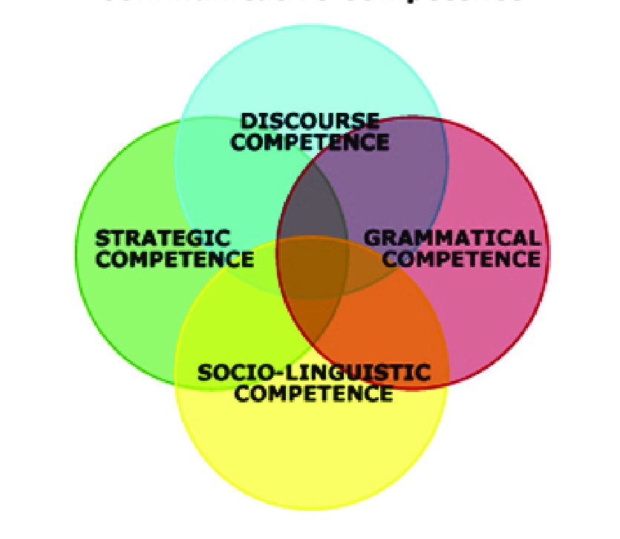
Communicative Competence
Communicative competence is the intuitive functional knowledge and control of the principles of language usage.
A language user needs to use the language not only correctly (based on linguistic competence), but also appropriately (based on communicative competence).
Components of communicative competence –
Linguistic
Sociolinguistic
Discourse
Strategic

Slide 7
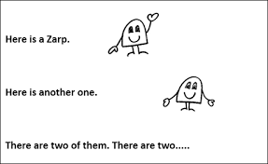
1. Linguistic Competency
The term linguistic competence refers to the unconscious knowledge of grammar that allows a speaker to use and understand a language.
Essentially means knowledge of Grammar and Vocabulary.
Knowledge of Linguistics –
Phonetics – Sounds & pronunciation.
Phonology – Rules of sound pattern (syllables).
Morphology – Word formation.
Syntax – Sentence structure.
Semantics – Meaning conveyed through language.

Slide 8
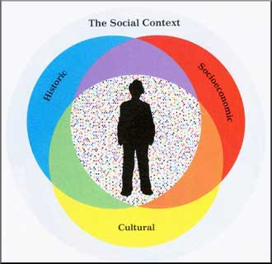
2. Sociolinguistic Competence
Sociolinguistic competence refers to the ability to use language that is appropriate to social contexts.
Social context refers to culture-specific contexts that include the norms, values, beliefs, and behavioural patterns of a culture. For example, thanking a friend in a formal speech is different from how it is done over a meal.
Also refers to the ability to select topics that are appropriate for a communicative event. For example, expressing strong views about politics and religion over dinner is generally avoided.

Slide 9

3. Discourse Competence
The knowledge of how to produce and comprehend oral or written texts in the modes of speaking/writing and listening/reading respectively.
Deals with organising words, phrases and sentences in order to create conversations, speeches, poetry, email messages, etc.
The two main aspects of discourse competence are cohesion and coherence.
Cohesion refers to using linking expressions, such as
conjunctions or adverbial phrases, to connect ideas.
A coherent text is one that makes sense.

Slide 10
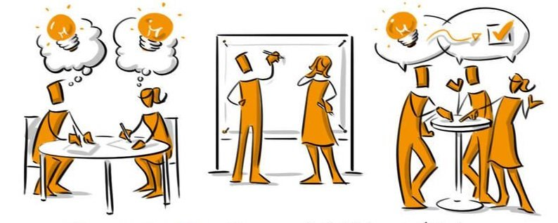
4. Strategic Competence
The ability to recognise and repair communication breakdowns before, during, or after they occur.
For instance, the speaker may not know a certain word, thus will plan to either paraphrase, or ask what that word is in the target language
If the communication was unsuccessful due to some factors (such as interruptions or misunderstanding), the speaker must know how to restore communication.
These strategies may be requests for repetition,
clarification, slower speech, or the usage of
gestures, taking turns in conversation etc.

Slide 11
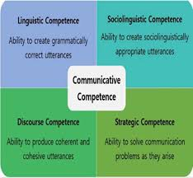

Slide 12
THANKS

